Slide 1
Flight with Pride!!! (Airplane Management System)
By:
1)Ibad Zaidi(20K-0152)
2)Faraz Khuwaja(20K-0121)
3)Muhammad Ali(20K-0334)

Slide 2
Introduction and Overview of the project
Flight with pride, an airline management system is a step towards improving the airline facility of Pakistan both for the users and airline companies.
For users, this development will make the air ticket purchasing procedure much simpler and secure.
Users will be able to view their travelling history through this application in an efficient way and would be able to avail discounts for certain events.
For airline companies, this application will help them in communicating with their passengers much effectively through our feature of “making announcements”.
Moreover, the process of payment would become much efficient using digitalized payment methods.
Further, the process of generating tickets will become much quicker using this application.

Slide 3
List of Objects
Admin
User
Bank account
Airline
Flight(inherit by Airline)
Ticket
Menu(abstract class)

Slide 4




Object interaction diagram

Slide 5
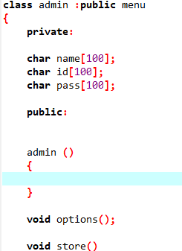
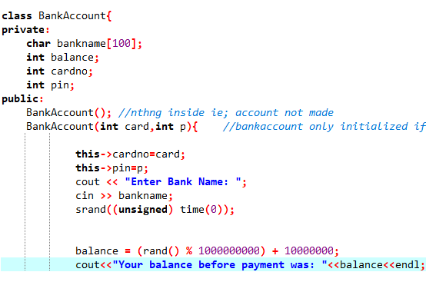
Encapsulation
In object-oriented computer programming languages, the notion of encapsulation (or OOP Encapsulation) refers to the bundling of data, along with the methods that operate on that data, into a single unit.

Slide 6
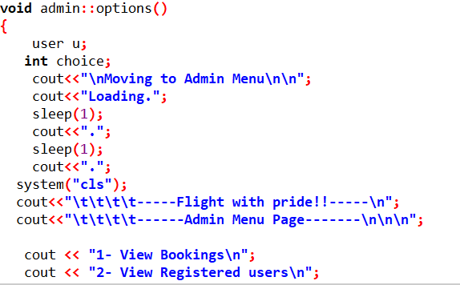
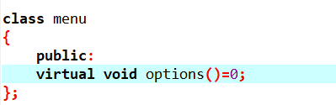
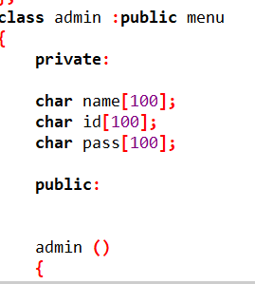
Abstraction
Data abstraction refers to providing only essential information about the data to the outside world, hiding the background details or implementation.

Slide 7
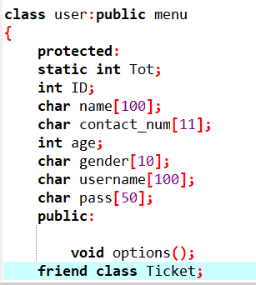
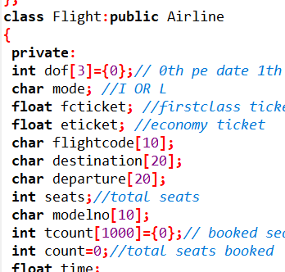
Inheritance
The capability of a class to derive properties and characteristics from another class is called Inheritance.

Slide 8
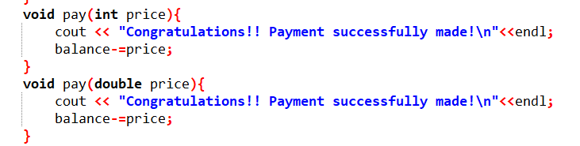
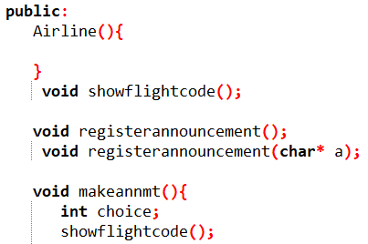
POLMERISATION STATIC(FUNCTION OVERLOADING)
Polymorphism is the ability of any data to be processed in more than one form

Slide 9
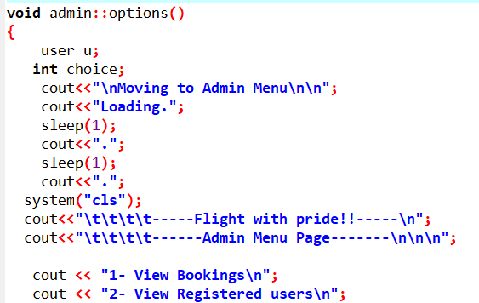
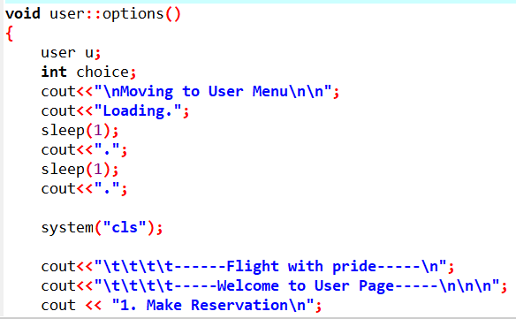
POLMERISATION STATIC(FUNCTION OVERRIDDING)
Function overriding means using a function of same signature in two different classes.

Slide 10
Motivation
This idea came up to our mind when we were actually travelling myself to Saudi Arabia for Hajj. On approaching to even some of the most famous airline companies, we found that their methods of payment were not at all flexible and the process of generating a ticket took days. Further, their methods of data collection too seem insure to me as it included a lot of paper work instead of modern data bases. Another flaw in the airline management system that I didn’t faced but some of my relatives do face was the process of announcement which was an absolute failure as when they reached the airport for their departure, at that time they got to know that their flight will be delayed by around 8 hours. These loopholes provoked me to make a platform with my classmates to solve these flaws in the airline management system of Pakistan.

Slide 11
Thank You

